Slide 1
Gun Trends in the United States
Analysis of gun ownership and usage in the 50 United States
Danielle Perkins
Ken Snyder
Tim DeRousse

Slide 2

Questions asked
What are the trends in gun ownership ?
Background checks vs. population
Background checks vs. new guns produced
Handguns vs. long guns
Cumulative effect: total background checks per state

Slide 3
Questions asked
What are guns used for ?
Comparison of long guns produced & hunting permits
Comparison of the number of hunters and tags issued
Handgun usage data

Slide 4
Core Research Hypothesis
While people are buying more guns for a variety of reasons, many of which are not subject to empirical testing, the number of handguns purchased in the United States is increasing.
The majority of guns available to the general public are not being used for hunting.

Slide 5
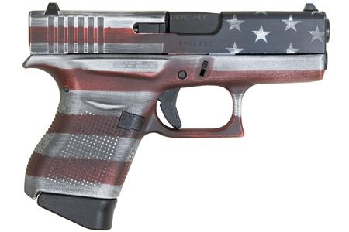
Data Sources
Population information from:
United States Census Bureau
https://www.census.gov
Background Check Information from:
NICS
Manufacturing Inport/Export data from: ATF
https://www.atf.gov

Slide 6

Data Sources
Licenses for hunting and hunting tags issued by state
Retrieved from the U.S. Fish and Wildlife Service
Historical License Data at:
https://wsfrprograms.fws.gov/Subpages/LicenseInfo/Hunting.htm

Slide 7
Methodology
Data Collection
Sources
Clean-up
Jupyter notebook
Presentation development
Charts and Graphs
Data Analysis
Team consideration of averages and comparisions

Slide 8
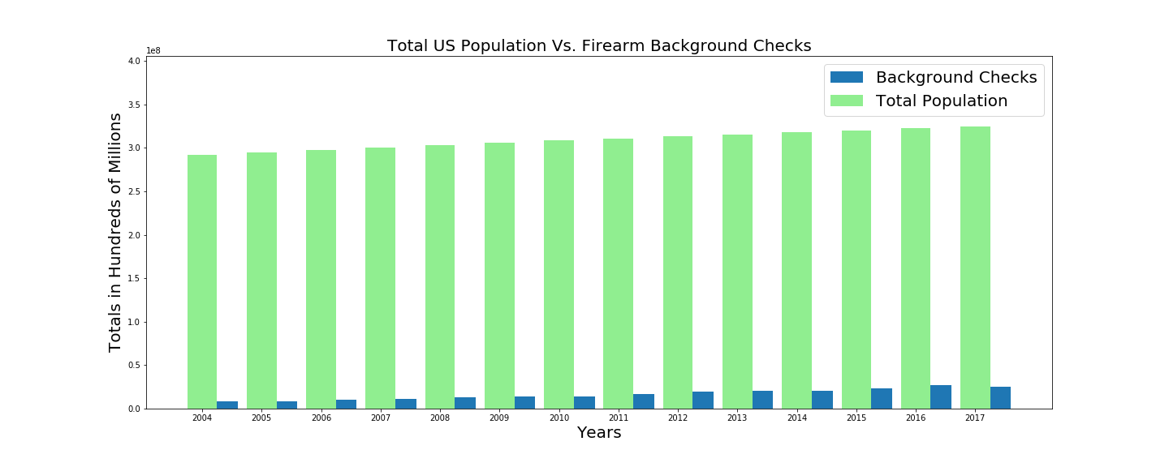

Slide 9
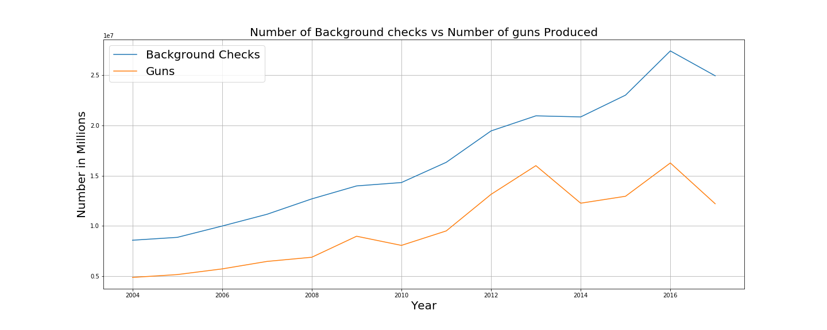
Background Checks vs. Gun Production

Slide 10
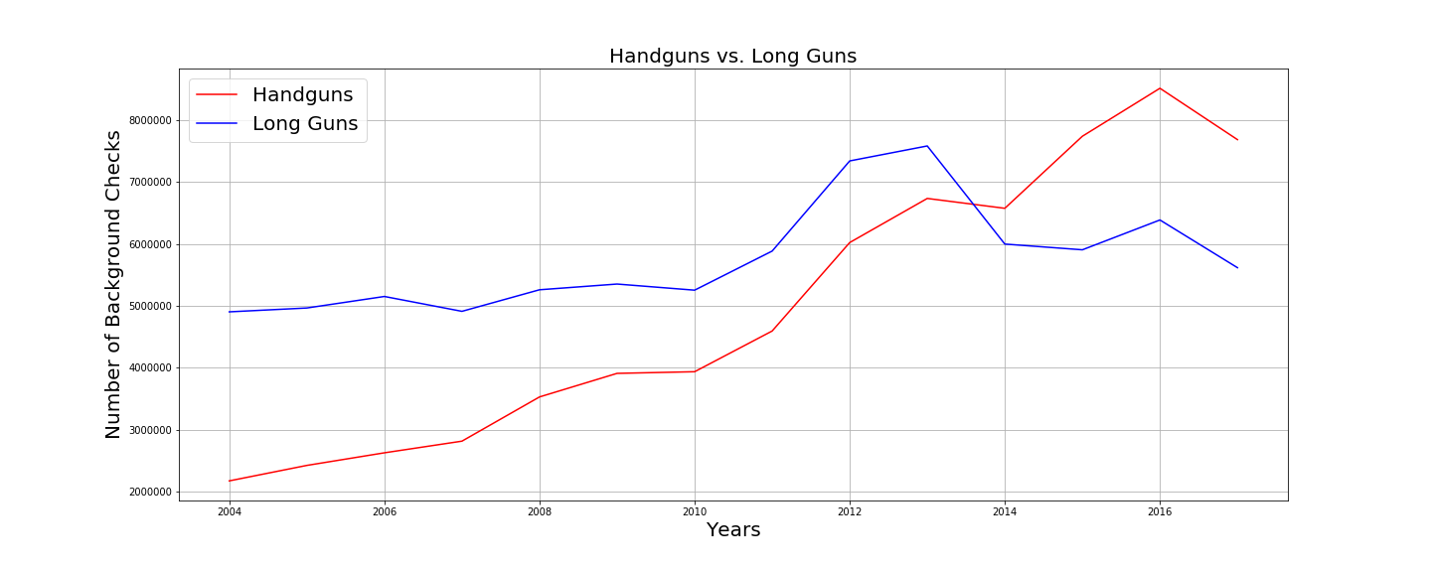
Handgun vs. Long Gun applications

Slide 11
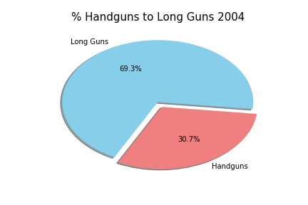
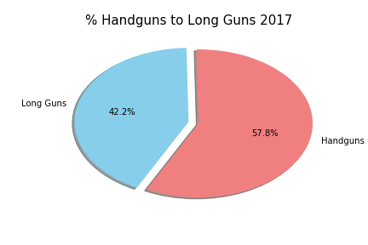
Background checks for Hanguns vs. Long guns
2004
2017

Slide 12
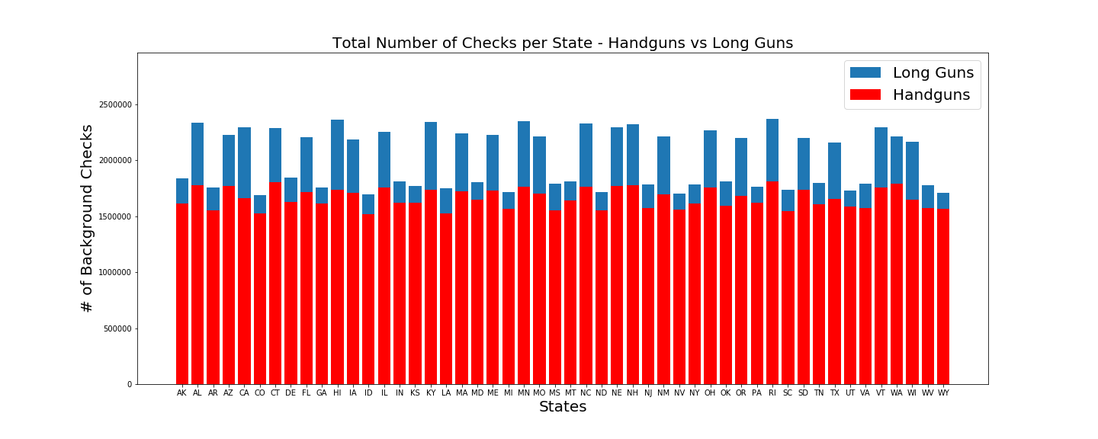
Handguns vs. Long Guns per State Cumulative data 2004 - 2017

Slide 13
Hunting Licenses per Year

Slide 14
Hunting Tags Issued

Slide 15
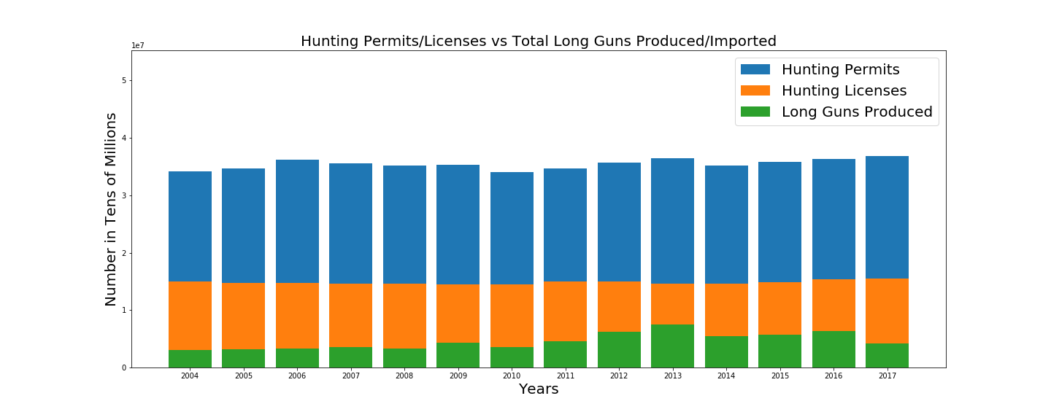
Licenses & Permits compared to Long Guns Produced

Slide 16
Conclusions
Background checks are representative of new gun purchases.
A relatively small number of persons purchase guns compared to the total population. In addition, all guns purchased are not necessarily for use by the general public.
The number of serious hunters (those who obtain tags) appear to be stable relative to the number of new guns available for use. Cumulative analysis might be expected to strengthen this point.
The preference in gun ownership; handguns vs. long guns has changed dramatically within the last 4 or 5 years, with handguns surpassing long gun purchases.
The majority of guns available to the general public are not being used for hunting, although there is insufficient data to determine the usage of handguns.

Slide 17
Limitations to Project Scope
There is a variety of data either unavailable or not discovered during the research and analysis of the current project including, but not limited to:
Guns removed from service nationally and by state per year
Hand gun useage other than those specifically identified as related to crimes committed, although this information is unreliable at best.
“Other” gun types not specified as handguns and long guns.
Limitations inherent in the selected period in trend analysis
Errors and omissions in raw data, the need for normalization.

Slide 18
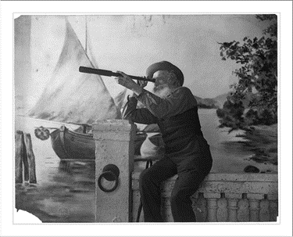
Limitations in Period Scope

Slide 19
Follow-up Projects
Analysis of the impact of law enforcement and military applications of gun production
Analysis of the changes in gun ownership by type of gun and in total in relation to historical and world political and economic events
Gender specific usage of guns by type and location per year.
Analysis and comparison of the impact of gun purchases and social concerns such as trends in mental illness and substance abuse
Analysis of gun ownership by city type; rural, suburban and urban

Slide 20
Thanks ! Any Questions ?

